Slide 1
CONSTRAINTS

Slide 2
TOPICS TO BE DISCUSSED
DEFINITION OF CONSTRAINTS
EXAMPLES OF CONSTRAINTS
TYPES OF CONSTRAINTS WITH EXAMPLES

Slide 3
CONSTRAINTS
In order to solve a set of differential equations for the motion of a system of n-particles, we have to impose certain restrictions on the positions and velocities of the particles of the system. Such geometrical or kinematical restrictions on the motion of a particle or system of particles are called constraints.
EXAMPLES OF CONSTRAINED MOTION
The motion of a rigid body restricted by the condition that the distance between any of its two particles remains unchanged.
The beads of an abacus constrained to one dimensional motion by the supporting wires.
Motion of the gas molecules within a container restricted by the walls of the vessel.

Slide 4
TYPES OF CONSTRAINTS
HOLONOMIC AND NON HOLONOMIC
SCLERONOMIC AND RHEONOMIC

Slide 5
Holonomic Constraints:
For a constraint to be holonomic its conditions must be expressible as equations connecting the coordinates of the particles (and , if possible, time also) i.e. in the form of equation
:
F(r₁ ,r₂,………,r_{n}, t)=0
Where r ₁,r₂,………..,r_{n} represent the position vectors of the particles of a system and t the time.
Hence, a holonomic constraint depends only on
the coordinates and time .
It does not depend on the velocities.

Slide 6
EXAMPLES OF HOLONOMIC CONSTRAINTS
CONSTRAINTS INVOLVED IN THE MOTION OF RIGID BODIES:
l r_{i} – r_{j}I²= C_{ij}²
where C_{ij} are constants and r_{i} and r_{j} are the position vectors of ith and jth particles.

Slide 7
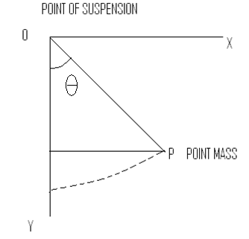
Constraints involved in the motion of the point mass of simple pendulum
| r– a | = l²

Slide 8
NON-HOLONOMIC CONSTRAINTS
If the conditions of the constraints cannot be expressed as equations connecting the coordinates of particles of the system, they are called non-holonomic constraints.
The conditions of these constraints are expressed in the form of inequalities.

Slide 9
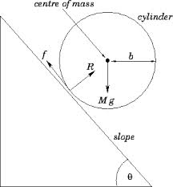
Examples of non-holonomic constraints
constraints involved in the motion of a particle placed on the surface of solid sphere i.e.
r² –a² >0 where a is the radius of the sphere.
constraint on an object rolling on a rough surface without slipping.
constraints involved in the motion of gas molecules in a container i.e.
r³ <= a³

Slide 10
SCLERONOMIC CONSTRAINTS:
The constraints which are independent of time are called scleronomic constraints e.g.
a bead sliding on a rigid curved wire fixed in space

Slide 11
RHEoNOMIC CONSTRAINTS
The constraints which contain time explicitly are called rheonomic constraints. e.g.
1) a bead sliding on a rigid curve wire moving in some prescribed fashion.
2)if we construct a simple pendulum whose length changes with time
i.e. l=l(t) then the constraints expressed by the equations are time dependent, hence, rheonomic .

Slide 12
An example to illustrate the difference between holonomic and non- holonomic constraints
The motion of a particle constrained to lie on the surface of a sphere is subject to a holonomic constraint.
But if the particle is able to fall off the sphere under the influence of gravity, the constraint becomes non-holonomic.

Slide 13
THANX

