Slide 1
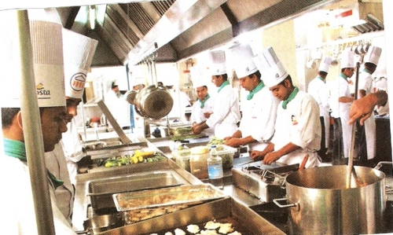
INSTITUTIONAL MANAGEMENT
PREFACE
What is management,
catering,
food service
Types of food service
advantages and disadvantages

Slide 2
MANAGEMENT
Management can be defined as the art of bringing together available resources including the abilities of different people , organizing them in scientific and orderly manner, to achieve a desired goals of the organization while promoting individual aspiration.
Management is the continuous process in which :
People work together to achieve common goals .
Establishing objectives, putting together all the human and material resources in best possible manner
Creating atmosphere of cooperation and good will
Development of people.

Slide 3
DEFINATIONS :
Institutional food management or catering : as it is usually called the art of providing food and drink aesthetically and scientifically to a large number of people in a satisfactory and cost effective manner.
e.g. eating outside ( same food but cost difference).
Catering : is the business of providing foodservice at a remote site or a site such as a hotel, public house (pub), or other location.
Food Service or catering : industry defines those businesses, institutions, and companies responsible for any meal prepared outside the home. This industry includes restaurants, school and hospital cafeteria, catering operations, and many other formats.
To plan a profitable menu in the foodservice industry, the menu planner must be knowledgeable about foods, management, and financing.

Slide 4
Catering : is food prepared by professionals to be served to a group of people at a designated place for a designated time and fee.
Types of Catering There are two main types of catering:
on-premise,
off-premise.
On-premise catering refers to food prepared and served in the same location to a group of people.
Off-premise catering is food that is prepared in a kitchen and transported to the location where it will be served to a group of people.( transportation by vehicle is a main difference.)
It complicates food safety issues such as packing safely to keep hot foods hot and cold foods cold, and to avoid spoilage. This is accomplished by using:
insulated coolers,
refrigerated vehicles, and
portable warming units.

Slide 5
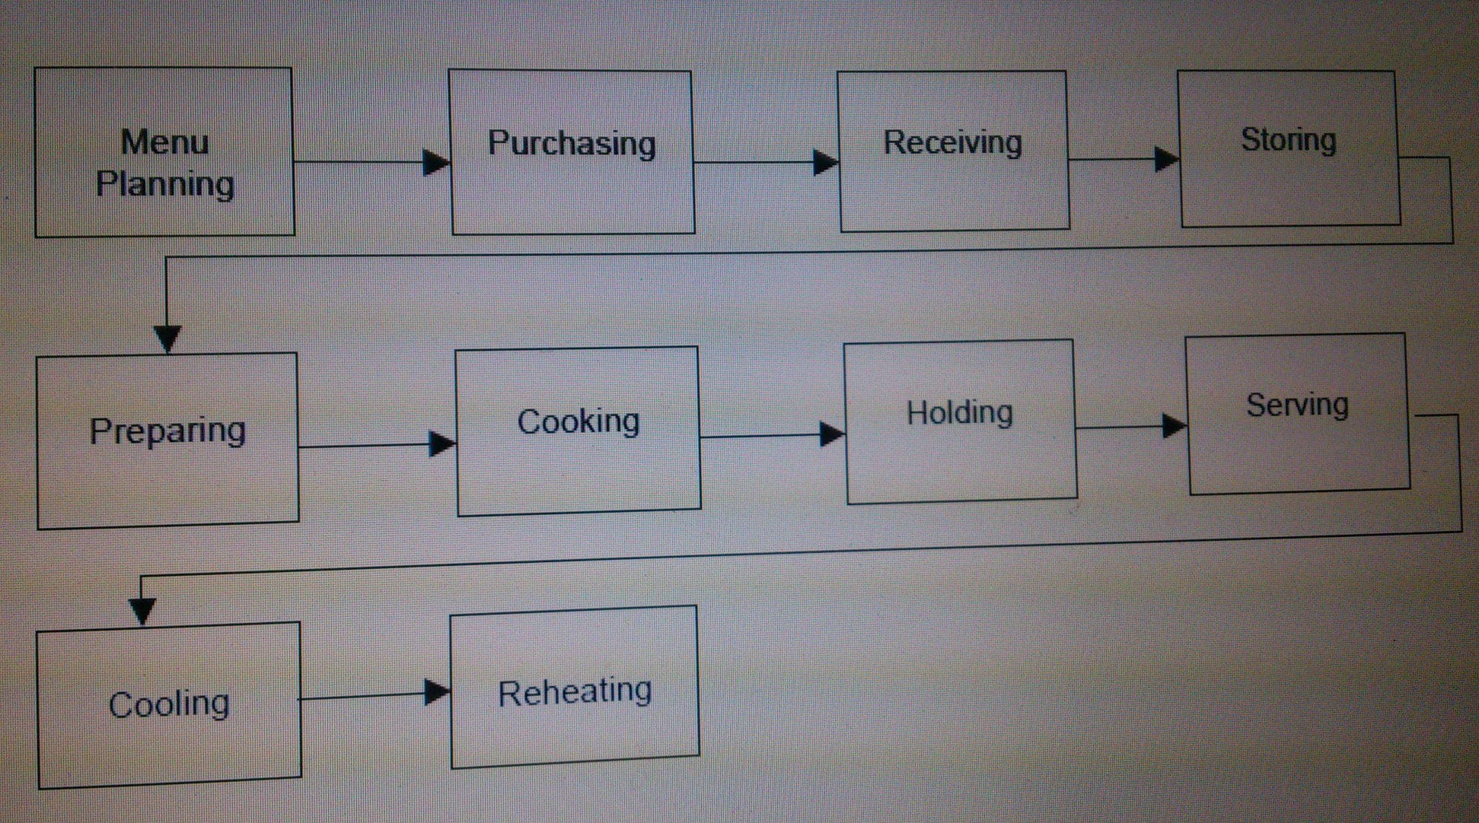
Flow of Food

Slide 6
Types of Foodservice Systems
There are Four types of foodservice systems
CONVENTIONAL,
COMMISSARY,
READY-PREPARED,

Slide 7
CONVENTIONAL FOOD SERVICE
The conventional foodservice system is most common. In conventional foodservice systems, ingredients are assembled and food is produced onsite, held either heated or chilled, and served to customers.
Conventional foodservice systems are used extensively in schools, restaurants, colleges and universities, and cafeterias.
Advantages of Conventional Foodservice Systems
High degree of perceived quality —this system makes people think of fresh
and homemade food products, which people often equate with quality.
Flexibility in menu items— any menu item can be included on the menu because food is prepared and served soon after production.
Food is served soon after preparation— which means that most often
freezing, chilling, or reheating typically does not impact the quality of the
food product.

Slide 8
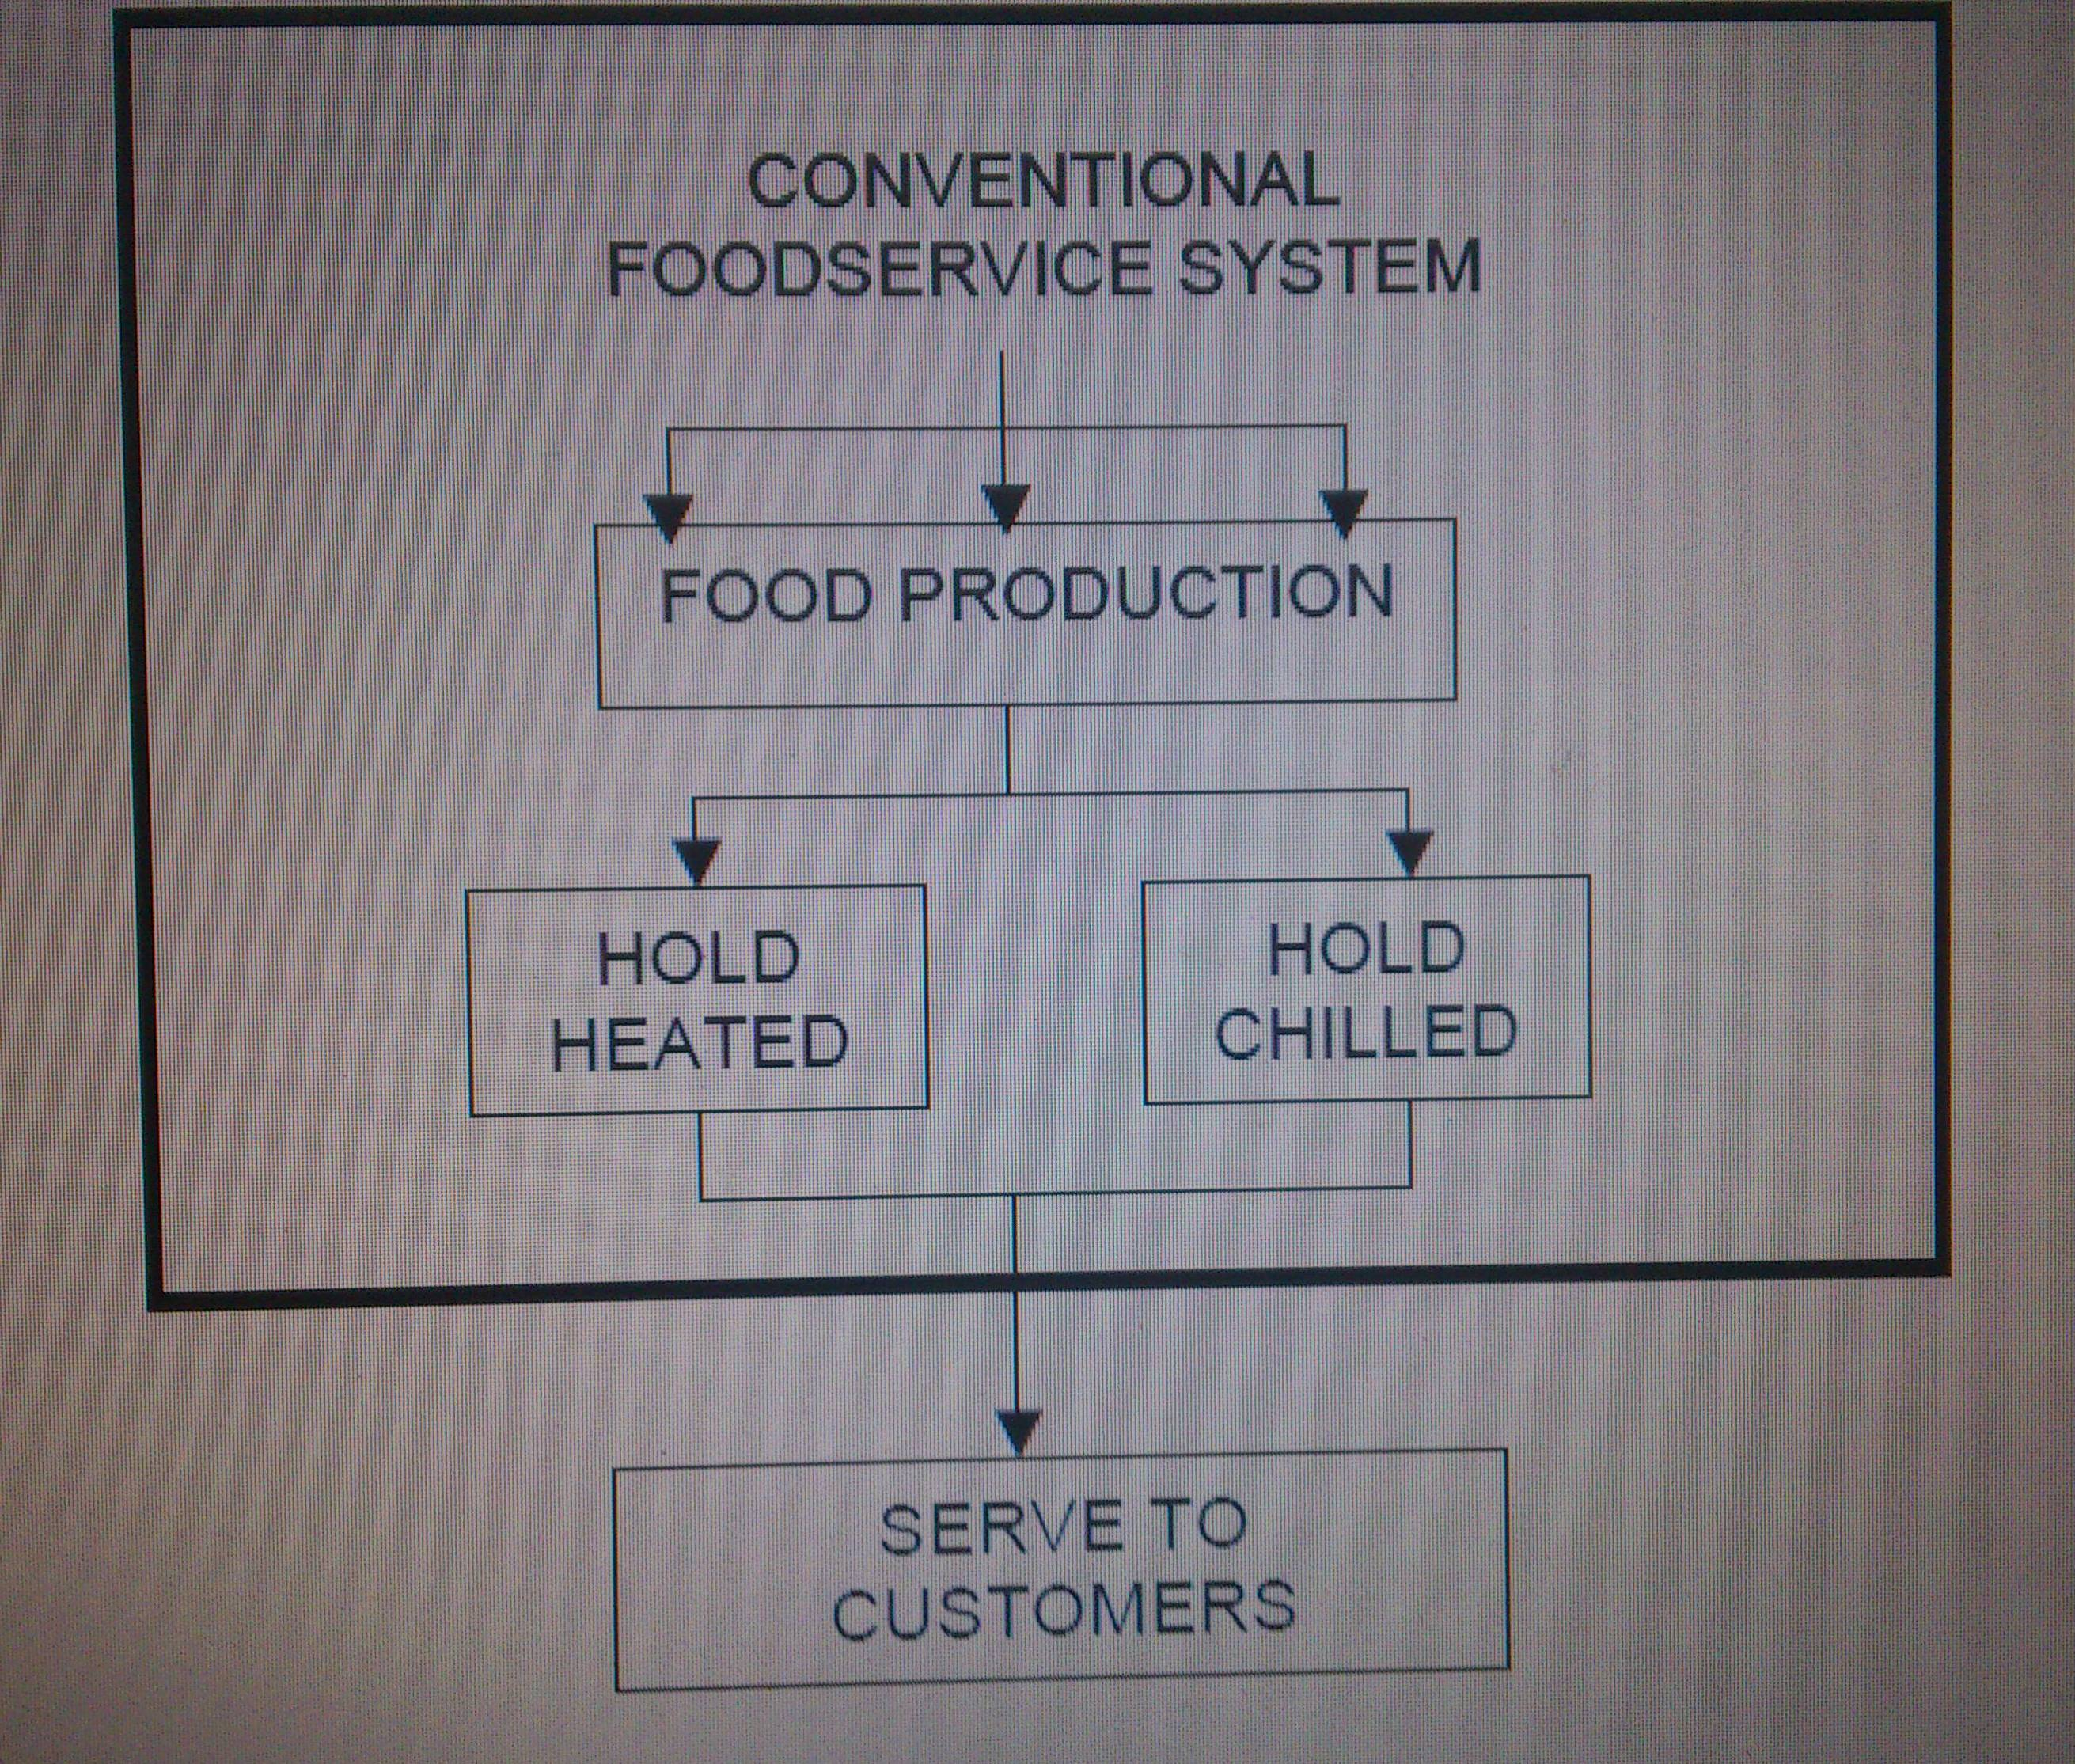

Slide 9
Disadvantages of Conventional Foodservice Systems
Labor intensive : preparation is timed in relation to when the food will be served and eaten,(more affected by the peaks and valleys of demand for food), More labor will need making the cost of labor higher for this system
Consistency— may be a problem if there are several conventional kitchens. There may be great variability in food quality, portion sizes, and food costs due to unskilled labor.
Higher food costs— higher costs could result because there is less control of portion sizes, more deliveries are required by the vendors, and waste may be greater.
Food safety— there is less control over food safety in conventional foodservice systems compared to other.

Slide 10
CENTRALIZED (COMMISSARY) FOOD SERVICE SYSTEM
The commissary food service system (also known as central kitchen, central food production, or food factory) centralizes food production, and food is transported to satellites (receiving kitchens) where it is served to customers. food preparation is done in the central kitchen, which results in lower food costs.
Labor costs also are lower because of the centralization of food preparation.
This food service system takes advantage of economies of scale, so it is most effective when mass food production is required.
One unique characteristic of the centralized foodservice system is that food is transported to external locations (satellites or receiving kitchens) for service. Two factors will need to be considered about the food that is transported: temperature (either hot or cold), and packaging.

Slide 11
The food can be sent to the receiving kitchens bulk or pre-plated, which impacts the equipment and labor needed at the receiving kitchen.
E.g.. airline industry. There is a central production facility on or near the airport property where the food is prepared, pre-plated, sealed, and either chilled or frozen. The pre-plated meals are placed in closed carts, and the trays with the cold items are assembled and placed in closed carts. These carts are transported by truck to the airplane (satellite), where the food is placed in the galley.

Slide 12
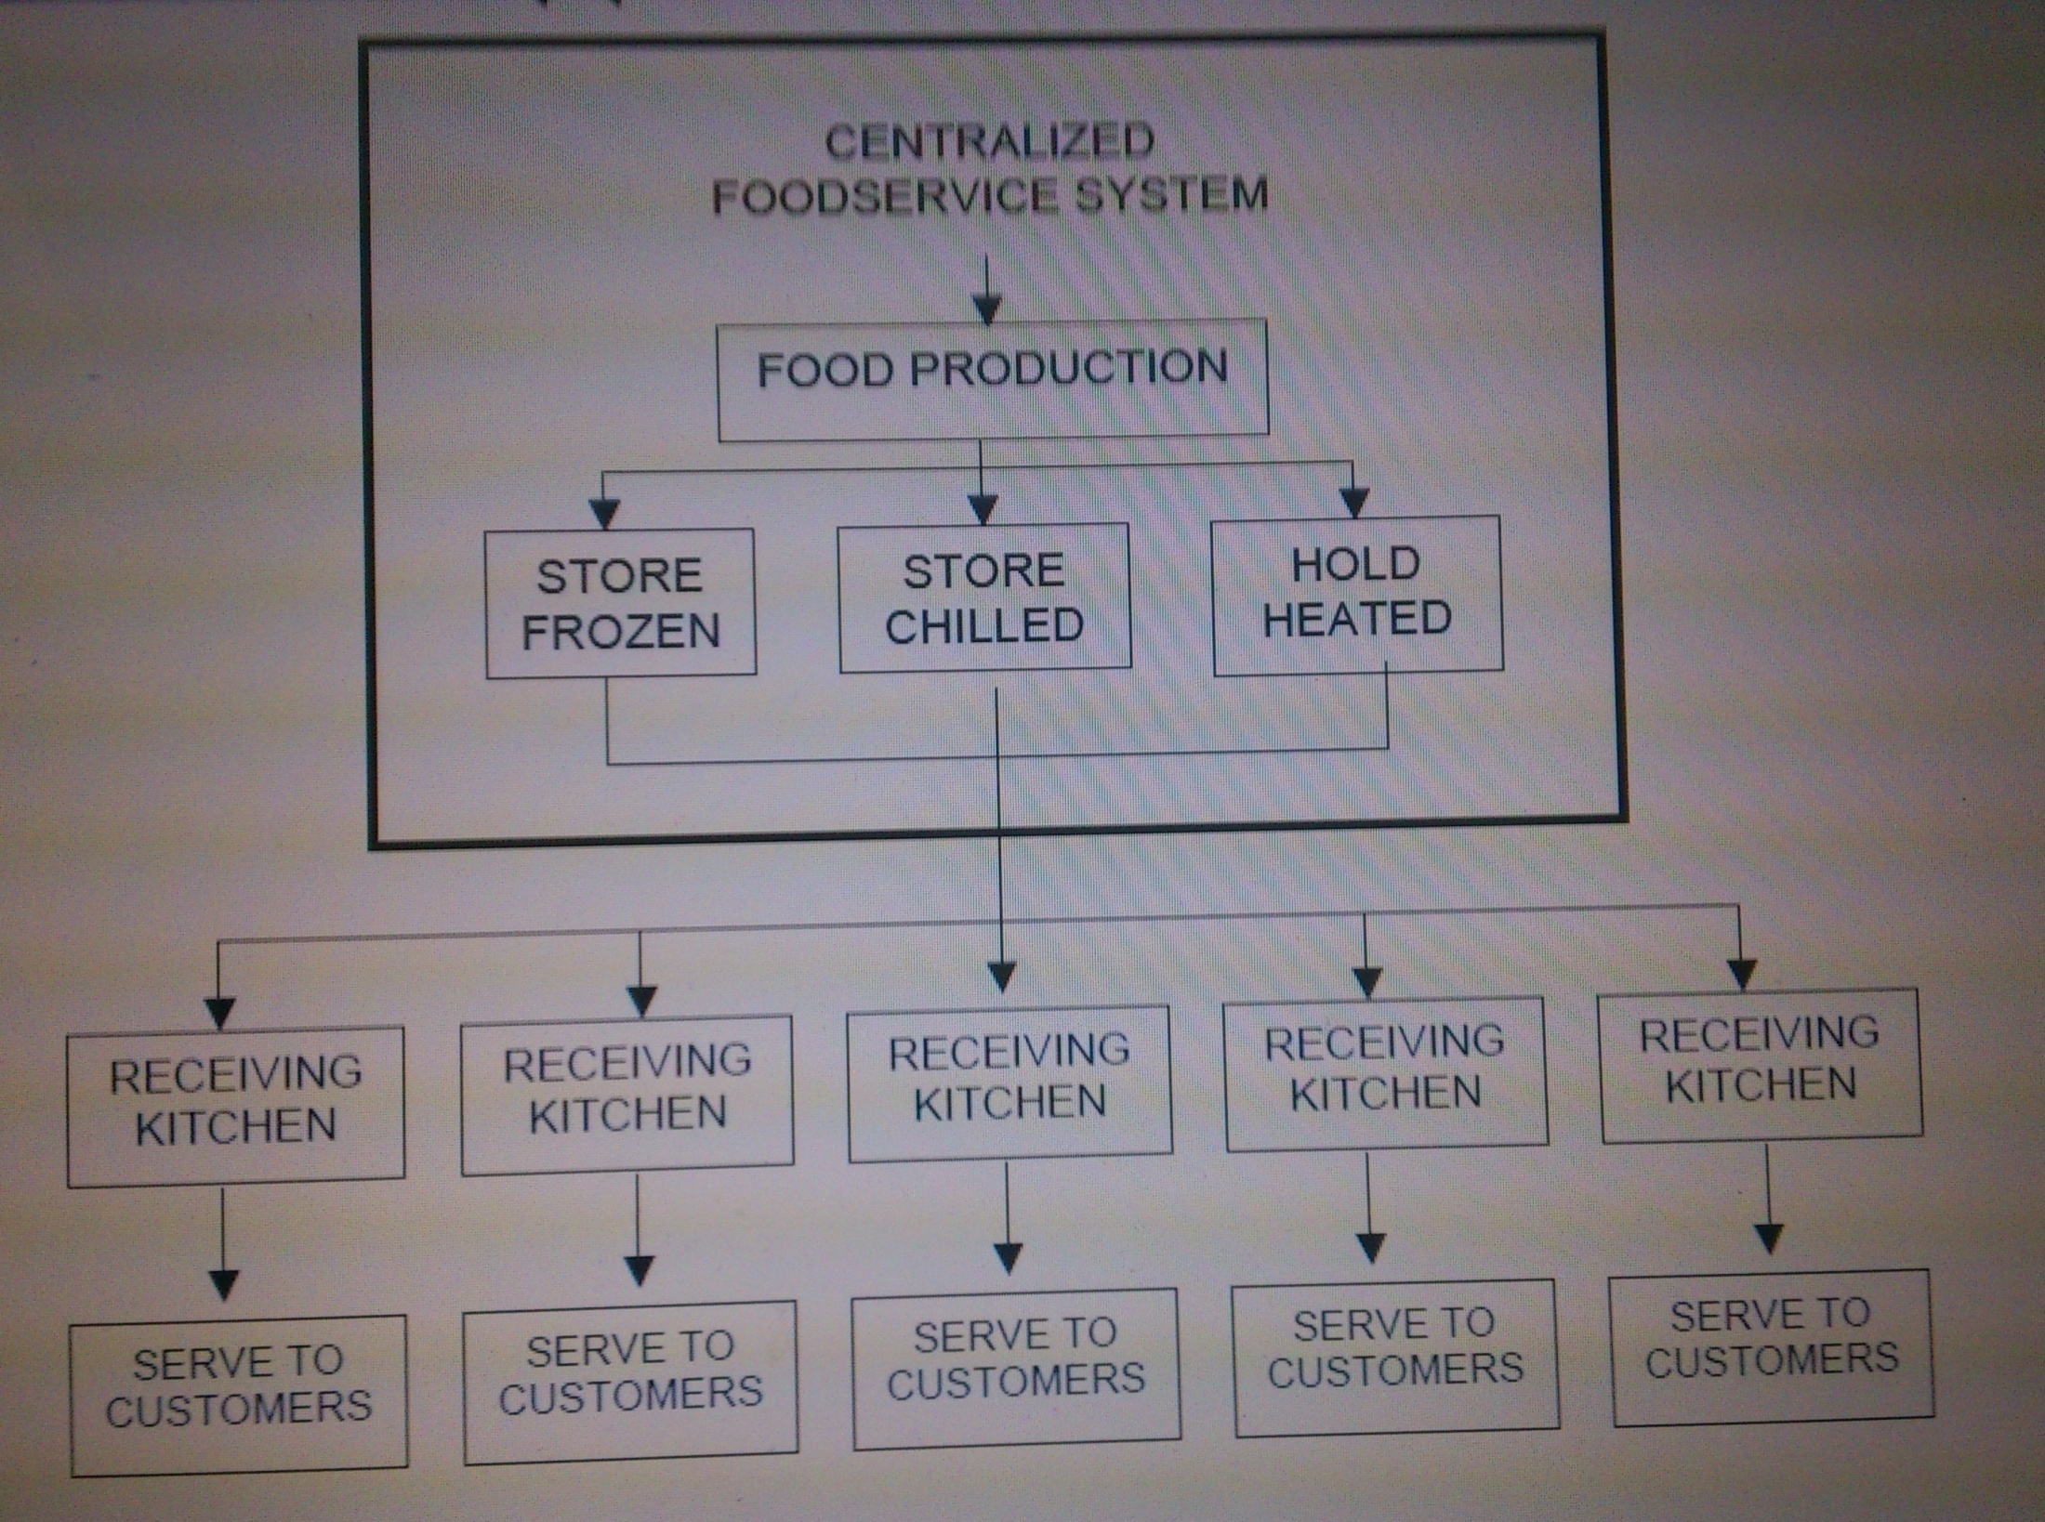

Slide 13
Advantages
Lower food and supply costs—
Purchasing Power
Ingredient control is improved— with a centralized foodservice system, there is greater control over ingredients, which decreases food costs.
Inventory control : there is good inventory turnover so that spoilage does not occur and food quality is maintained.
Lower labor costs
Quality control—central food production provides the opportunity to have more
quality control in the food served,
Consistency

Slide 14
Disadvantages of Centralized Foodservice Systems
High initial capital investment for building and equipment
More technically skilled employees are required—
Equipment malfunctions can be significant
Transportation costs
Food safety problems can affect many customers

Slide 15
READY-PREPARED FOODSERVICE SYSTEM
In ready prepared foodservice systems, food is produced onsite, held chilled or frozen, reheated, and served to customers on site.
This system also allows multiple-day production to be done at one time.
Cook- chill is a method in which items are partially cooked, rapidly chilled, held in chilled storage, and reheated just prior to service.
Cook-freeze is a method in which items are partially cooked, rapidly frozen, held in a freezer storage, and reheated just prior to service.
Sous vide – a process of sealing raw, fresh food items in plastic pouches to allow chilled storage and then cooking in boiling water prior to service.

Slide 16
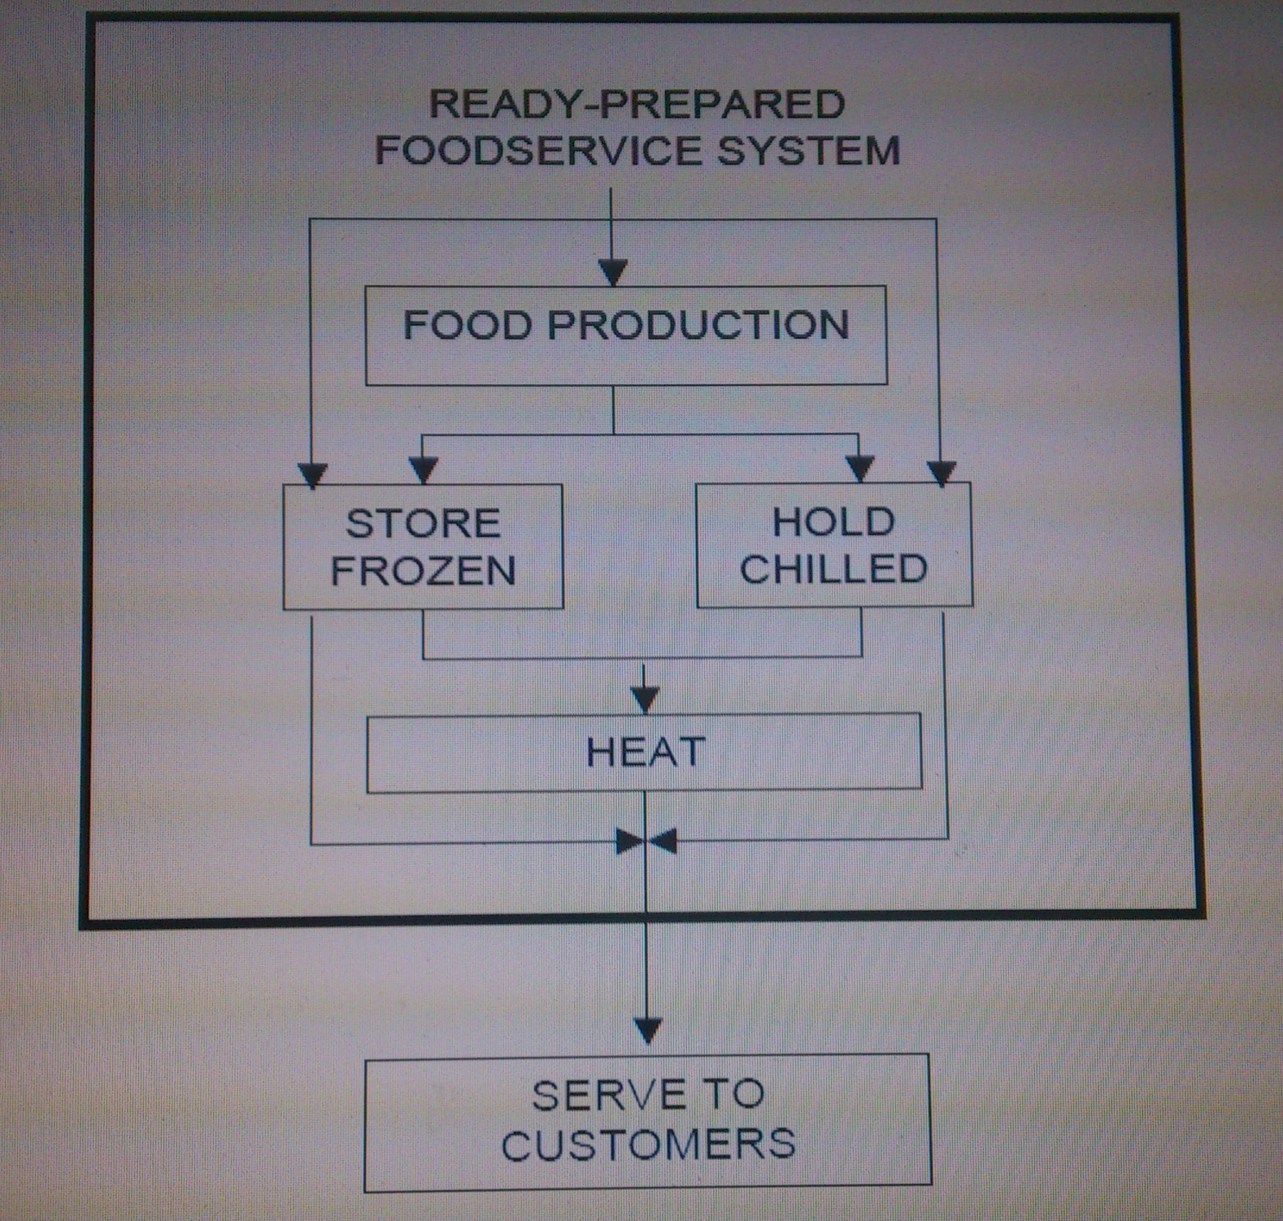

Slide 17
Advantages of Ready-Prepared Foodservice Systems
Flexibility in scheduling food preparation— if food is prepared and stored frozen or chilled for later use, there is a great deal of flexibility in the scheduling of food production.
Lower labor costs— large quantities of food can be prepared at one time and stored

Slide 18
Disadvantages of Ready-Prepared Foodservice Systems
Menu variety may be limited
High initial capital investment for equipment
Perceived loss of quality—
Food safety problems can affect many customers

Slide 19
NON COMMERCIAL FOODSERVICE SYSTEM
It is supplying food service that is operated by a business, educational programs, governmental or institutional organizations. Two type of non-commercial foodservice operation :
Self-operated and
Contract management Company-Operated
SELF-OPERATED : noncommercial foodservice operation in which the program is managed and operated by the organization's own employees
CONTRACT MANAGEMENT COMPANY-OPERATED : noncommercial foodservice operation in which program is managed and operated by a company specializing in foodservice management

Slide 20
NON COMMERCIAL OPERATIONS
Making no net profit at all. Partially or fully subsidized by government or industry for the benefit of its employees or intimates.
Social organizations: city clubs, country clubs host dinners and festive events. Visits to temples on religious events.
Welfare and rehabilitation: governmental and non governmental organizations who look after the needy sections of the society in an institutional manner.
E.g. orphanages ,day care centers, prisons, old age homes.
Health and medical care: provide catering facilities for inmates, staff and visitors. Welfare services are planned by the government to help eradicate hunger and malnutrition through local public health centers and schools.

Slide 21
Institutional feeding: welfare centers , crèches, orphanages, set up by government, public and private institutions all need to feed and care for their inmates to the different age group with there needs.
Entrepreneurial ventures: catering services started by individuals or families for some creative idea. Supply of lunches for children and old people in families.
Franchising: expanding their units throughout the country in a satellite manner.
Tourism and travel: overnights lodges and motels providing eating and resting .(portables meals)
E.g yatri niwas, yatrikas , midways

Slide 22
Commercial food services:
RESTAURANTS: it is derived from the latin word restaurare which became restauer, in French , meaning to repair ,replenish or restore.
Earlier menu were pasted on the wall or door to attract attention of those who passed by.
The first restaurant opened was in Paris in 1765 by a soup vender followed by England where a meal was provided at a fixed hour which later become meeting place of people.
A restaurant is an establishment which prepares and serves food and drink to customers in return for money, either paid before the meal, after the meal.
Meals are generally served and eaten on premises, but many restaurants also offer take-out and food delivery services.
Restaurants often specialize in certain types of food e.g theme. For example, there are seafood restaurants, vegetarian restaurants or ethnic restaurants.,
restaurants selling food characteristic of the local culture are simply called restaurants, while restaurants selling food of foreign cultural origin may be called ethnic restaurants.
Restaurants may also be classified on the structure of their menu or the style of offering food. For example, one might choose a tapas bar, a sushi train, a tastet restaurant, a buffet restaurant not only for the type of cuisine but for the way it is offered.

Slide 23
FAST FOOD RESTAURANT
Fast food is the term given to food that can be prepared and served very quickly. While any meal with low preparation time can be considered to be fast food.
Outlets may be stands or kiosks, which may provide no shelter or seating
A fast food restaurant, also known as a quick service restaurant (QSR). it, is a specific type of restaurant characterized both by its fast food cuisine and by minimal table service.
Food served in fast food restaurants offered from a limited menu; cooked in bulk in advance and kept hot; is finished and packaged to order; and is usually available ready to take away, though seating may be provided. Fast food restaurants are usually part of a restaurant chain or franchise operation.
fast food chains such as McDonald's and KFC are multinational corporations with outlets across the globe.

Slide 24
VALUE MEALS
A value meal is a group of menu items offered together at a lower price than they would cost individually. They are common at fast food restaurants.
On the go:
Fast food outlets are take-away or take-out providers, often with a "drive-through" service which allows customers to order and pick up food from their cars; but most also have a seating area in which customers can eat the food on the premises
Filling stations
Many petrol/gas stations have convenience stores which sell pre-packaged sandwiches, doughnuts, and hot food.
Many gas stations in the United States and Europe also sell frozen foods and have microwaves on the premises in which to prepare them.

Slide 25
Street vendors and concessions
Traditional street food is available around the world, usually from small operators and independent vendors operating from a cart, table, portable grill or motor vehicle.
Depending on the locale, multiple street vendors may specialize in specific types of food characteristic of a given cultural or ethnic tradition.

Slide 26
Points to be kept in mind
In the area of food, the menu planner must know the following:
The customer’s likes and dislikes regarding food.
Knowing which foods are preferred definitely helps the sale ability of a product.
How to identify the various food products that are available in
the markets.
How to explain the different criteria that establish the quality
grades of food products.
The availability of the food products. Knowing when a food
product is available helps keep food costs down and profits up.
How the food items are prepared, produced, plated, served, and
consumed by the guest. This information allows the menu planner to specify the type of equipment necessary to produce the food product..
How the food product is packaged, shipped, received, and stored,
as well as the shelf life of the product.

Slide 27
Commercial Foodservice
The commercial segment of the foodservice industry includes
Hotels
Restaurants
Clubs
Diners
Fast-food operations
Specialty shops
Cafeterias
Catering businesses
Vending businesses
Dinner theaters
Delicatessens

Slide 28
In each of these foodservice operations, the menu planner must know management’s point of view on the following:
How the operation is run
The type of clientele that management would like to attract
Check average
Decor
Profit margin
Competition
Market trends

Slide 29
Planning Considerations
For successful events, the caterer must anticipate and plan every step in the serving and eating process. Other arrangements, such as entertainment, flowers, tables, chairs, tents, and special equipment need to be considered..
Of all the details, the most important is the menu. Not only is the type of food important, but also other presentations must be carefully considered:
the style of serving,
how the portions will appear as they are served on plates,
plate garnishes,
room arrangements, and
design and traffic flow of the food buffet

Slide 30
difference b/w:
non-commercial
commercial foodservice
It is supplying food service that is operated by a business, educational programs, governmental or institutional organizations. Foodservices operation whose financial goal does not involve generating...
Commercial organization aim to make a profit from their commerce whereas non-commercial is based on non-profit for example charities.
Non-commercial catering companies generally purchase all of their own catering supplies and either make all of the food out of their home or have a small commercial kitchen.
Commercial food services are food service operations found in lodging properties, clubs, restaurants, and other business that exist to make a profit from the sales of food and beverage...
Commercial catering companies are usually on a much larger scale than non-commercial, and they usually work with hotels, convention centers, and large corporations.

Slide 31
Types Of Food Services
Counter service :
Counter service is a form of service in restaurants, pubs, and bars where food or drinks are ordered at the counter. Counter service is sometimes also referred to as a "bar service,“.
With counter service, the customer generally pays before consuming the food or drink. Some fast food restaurants offer only counter service .
Table service
Table service is food service served to the customer's table by waiters and waitresses, also known as "servers". Table service is the norm in most restaurants.
With table service, the customer generally pays at the end of meal.

Slide 32
Styles of service
Depending on the nature of establishment, and the requirement of particular occasion, food may be served in some formal and informal ways.
Waiter service
Self service
Vending ( mobile catring vans move place to place and park where customers are expected), also AUTO VENDING
Contract catering.
FOOD SERVICE STYLE
FORMAL SEMI FORMAL INFORMAL
(WAITER SERVICE) (WAITER/SELF SERVICE) SELF SERVICE
BANQUET FAST FOOD RESTAURANT CAFES
RESTAURANT CAFETERIA FAST FOOD OUTLETS
BUFFET BUFFET COUNTER SERVICE
ROOM SERVICE CANTEEN SERVICE
HOSPITAL SERVICE
TRAVEL SERVICES VENDING
---RAILWAY
---AIRLINE
BUS

Slide 33
Room service
Food is served in the room where a guests is staying.
Order is placed on the phone and the waiter brings the same to the room, on a tray 0r trolley and serves to the customers.
The time period is specified for which the services have to be povided to all at same time.
Railway service: food served to passengers on long train journey. In-transit and on station services.
Airline services: in- flight services (menu and service atyle according to the travel class, time and duration of flight.

Slide 34
Gueridon service :
Gueridon service is a form of food service provided by restaurants to their guests. This type of service encompasses preparing food in direct view of the guests, using a "Gueridon".
A gueridon typically consists of a trolley that is well equipped to prepare, cook and serve the food to the guest. There will be a gas hob, chopping board, cutlery drawer, cold store (depending on the trolley type) and general working area.

Slide 35
Tapas :are a wide variety of appetizers, or snacks, in Spanish cuisine. They may be cold (such as mixed olives and cheese) or warm. In select bars in Spain.
Sushi : is a Japanese food consisting of cooked vinegared rice (shari) combined with other ingredients . Neta and forms of sushi presentation vary, but the ingredient which all sushi have in common is shari. The most common neta is seafood.
Raw meat sliced and served by itself is sashimi.
Tastet is a word of Catalan origin meaning 'a small taste of food'. The tastet is a variation of the tapas serving style; larger and more complex than tapas but smaller than a plate. Emphasis is placed on taste and presentation

Slide 36
THANK YOU
KRITIKA MATHUR
MSC (2 YR)
FOODS AND NUTRITION

