Slide 1
GASTRO – INTESTINAL TRACT DISEASES

Slide 2
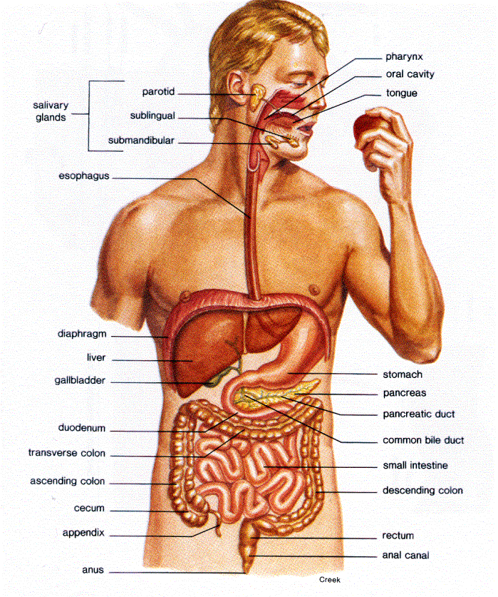
GASTROINTESTINAL TRACT
The human digestive system
is a complex series of organs
and glands that process,
absorb , digest food
and excret out the excreta.

Slide 3
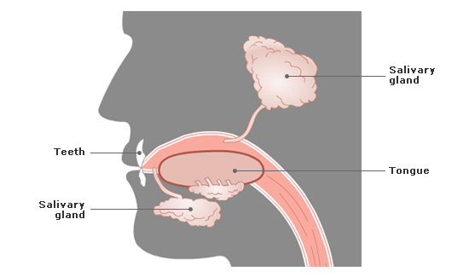
INGESTION and DIGESTION
MOUTH
It is a cavity and a first part of gastrointestinal tract, it is lined with a mucous
membrane .
Saliva contains
Salivary amylase Starch.
30% of CHO digest in mouth.

Slide 4
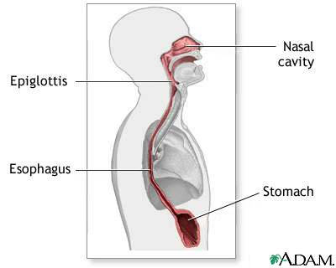
OESOPHAGUS
10 inches long .
Extended from the pharynx, through the diaphragm to the stomach.
To conduct food
From the mouth - stomach.

Slide 5
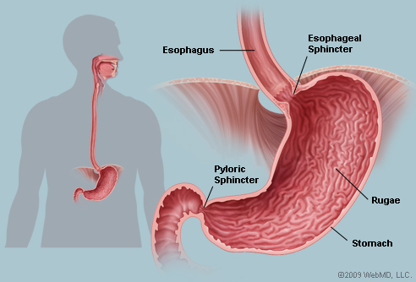
STOMACH
Muscular organ located on the left side of the upper abdomen.
Food enters the stomach- lower esophageal sphincter.
Ridges of muscle tissue (rugae ) - more surface area.
Gastric secretion contains :
HCL - pH- 1.35-3.5
-pepsin
-lipase
- intrinsic factor
Chyme
Normal level of gastric secretion:
2000-2500 ml/day
pyloric sphincter
-allow food to pass
-stomach - small intestine

Slide 6
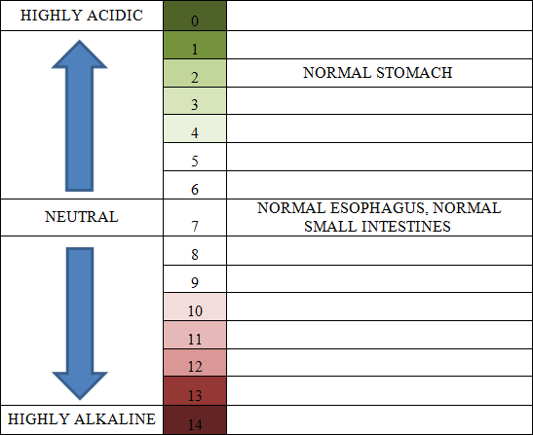
Ph level of GIT

Slide 7
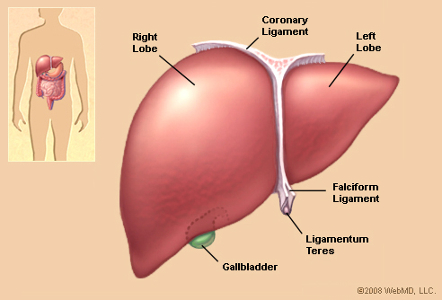
LIVER
Dark reddish brown gland located just behind the diaphragm
2 LOBES (right and left)
Production of bile
Glucose- Gycogen
Metabolism - proteins and fats
Storage of Vitamin- ,A,D,E,K
Remove toxins from blood .
Erthrocytolysis(pigment released
eliminated in bile called bilirubin)
Bilirubin gives stool its brown
color.

Slide 8
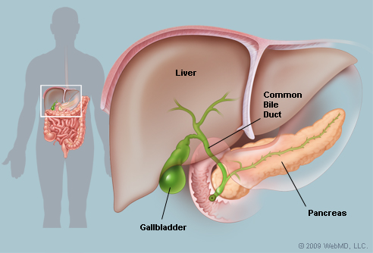
GALLBLADDER
Pear- shaped sac under the liver .
Stores bile produced by the liver.
Squeezes stored bile into the small intestine through
-Series of tubes called ducts
-helps to digest fats.

Slide 9
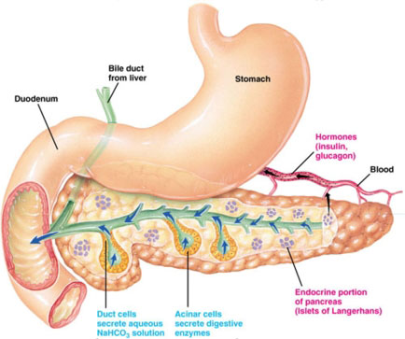
PANCREAS
Extended from below the stomach upto duodenum
Internal- endocrine function
-Insulin
-Glucagon
External-exocrine function
-Amylase- CHO
-Trypsin , chymotrypsin – protein
-Lipase-fat
Enzymes inactive
until reaches duodenum .

Slide 10
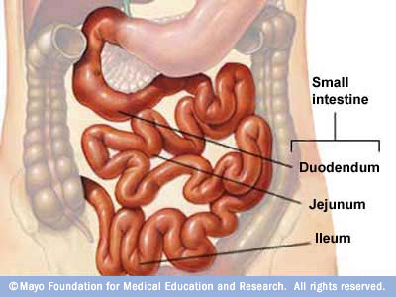
ABSORPTION and DIGESTION
SMALL INTESTINE
Made up of three segments
- Duodenum -10”(25 cm)
- jejunum- 1m(100 cm)
- ileum- 2m(200cm)
Chyme + bile + pancreatic
juices.
Absorption

Slide 13
VILLI

Slide 14
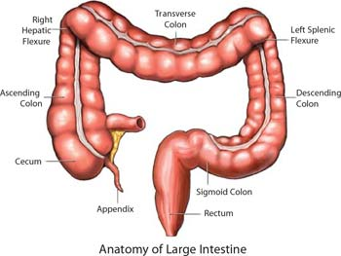
LARGE INTESTINE(COLON)
It continous with the small intestine and ends at the anus.
5 ft long.
Has six parts
-caecum
-the ascending colon
-the transverse colon
-the descending colon
-the sigmoid colon
-the rectum

Slide 15
Absorb water and electrolytes
Manufactures vitamins – k, biotin, B-12 , B -5
Produces mucus
- helps to lubricate intestinal mass
- neutralize the acid which is produced by bacteria in the large intestine .
Bile salts - reabsorbed in the cecum .
Pigments – Urobilins and sterobilins formed by the intestinal bacteria – provide brown color to feces.
Bacteria - 300- 1000 species - Lactobacillus acidophilus,
Escherichia coli , etc.
Gets Energy and Nutrients from the undigested food and other substances.

Slide 16
BACTERIAL ACTION on PROTEIN
Bacteria breaks down peptides remaining in the feces and generates –
Ammonia , in the form of soluble ammonium ions.
Indole and Skatole , two nitrogen – containing compounds that are responsible for the odor of feces.
Production of gases – Hydrogen sulfide,CO2 and Methane.
Significant amounts of ammonia and smaller amounts of other toxics cross the colonic epithelium and enter the hepatic portal cirulation .
These are removed by the liver and converted to nontoxic substances that can be released in the blood and excreted at the kidneys.

Slide 17
Bacterial Action on CHO
Carbohydrates Short chain fatty acids
(saccharolytic fermentation)
Acetic acid, Butyric acid, Propionic acid
Used by muscles Helps the liver-ATP
Energy to Gut cells

Slide 18
Helps to absorb the dietary minerals- Ca, Mg and Fe .
Gases
Organic acids – Lactic acid
(saccharolytic fermentation)

Slide 19
Neurotransmitters
neurotransmitter | site of release | Their actions
α- aminobutyric acid (GABA) | Central nervous system | Relaxes lower esophageal
Nor epinephrine | CNS , Spinal cord, sympathetic nerves | Decrease motility, increase contraction of sphincter, inhibits secretions
acetylcholine | CNS, autonomic system other tissues | Increases motility , relaxes sphincter , stimulates secretion
neurotensin | GIT , CNS | Inhibits release of gastric empting and acid secretion
serotonin | GIT , spinal cord | Facilitates secretion and peristalsis
Nitric oxide | CNS , GIT | Regulates blood flow, maintains muscle tone and motor activity
Substance p | GUT , CNS , skin | Increase sensory awareness , peristalsis

Slide 20
Hormones in Gastrointestinal tract
 | Hormones | released from | action
1. | Gastrin | anternal mucosa of stomach | stimulates gastric secretions and motility necessary for normal cell growth in the lining of stomach
2. | Cholecystokinin (CCK) | proximal small bowel | stimulates the pancreas to secrete enzymes gallbladder contraction stimulate colonic activity and regulate appetite Promotes cell growth

Slide 21
 | Hormones | Released from | action
3. | Secretin | Duodenal wall into blood stream | stimulates pancreas to secrete water and bicarbonates inhibits gastrin secretion stimulate stomach to produce pepsin stimulates liver to produce bile
4. | Glucagon – like peptide (GLP-1) | intestinal mucosa | decreases gastric empting lowers glucagon secretion stimulate insulin secretion increases insulin sensitivity and satiety
5. | motilin | Gastrointestinal tract | participates in controlling smooth muscle contraction in stomach and small intestine

Slide 22
LOWER
GASTROINTESTINAL DISEASES

Slide 23
CONSTIPATION
Physiological disorder of alimentary canal.
Infrequent bowel movements (typically three times or fewer per week).
difficulty during defecation ( a subjective sensation of hard stools).
the sensation of incomplete bowel evacuation.

Slide 24
NORMAL COLON
COLON WITH STOOL

Slide 25
CAUSES
SYSTEMATIC/METABOLIC | GATROINTESTINAL
Side effects of medication | Cancer
Abnormalities such as Diabetes, hypothyrodism ,hypercalcemia etc | Diseases of the upper gastrointestinal tract
Lack of exercise | Diseases of the large bowel resulting in anorectal malformations
Ignoring the urge to defecate | Irritable bowel syndrome
Vascular disease of the large bowel | Anal fissure

Slide 26
SYSTEMATIC/METABOLIC | GATROINTESTINAL
Systematic neuromuscular disease leading to deficient function of voluntary muscles | Laxative uses
Poor diet ,low in fiber pregnancy

Slide 27
TYPES
Atonic Constipation
Spastic Constipation
Obstructive Constipation

Slide 28
ATONIC CONSTIPATION
“Lazy bowel” syndrome .
Loss of intestinal muscle tone .
Causes
Lack of fluids
Lack of roughage
Lack of potassium
Vitamin B deficiency
Irregular habit
Purgation

Slide 29
SPASTIC CONSTIPATION
Excessive tone of colonic muscles which narrows the cavity and the forward movement of faeces is retarded.
CAUSES
Excessive use of purgatives
Irritating foods
Mental stress

Slide 30
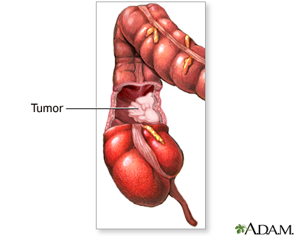
OBSTRUCTIVE CONSTIPATION
Any kind of obstruction or blockage in the stool passage results in obstructive constipation.
CAUSES
Tumor.
Cystic fibrosis.

Slide 31
DIAGNOSIS AND TESTS
Medical history
Patient’s dietary history
Physical activity level
Medications
Diseases
Duration of symptoms
Frequency of bowels movements
Toilet habits
Consistency of stool

Slide 32
Physical Examination
Scleroderma (autoimmune disorder).
Intestinal pseudo-obstruction (decreased ability of the intestines to move stool).
Hirschsprung's disease (enlargement of the colon that stops the flow of stool).
Irritable bowel syndrome (IBS).
Diverticulitis (formation of pouches in the colon) .
Chagas disease (tropical disease caused by a parasite).

Slide 33
Blood test - to rule out other conditions that can cause constipation such as :
Thyroid hormone (to detect hypothyroidism).
Blood glucose levels (to determine if diabetes is present) .
To examine hypercalcemia.
Serum cortisol levels (the stress hormone, that may indicate addison's disease (a disease of the adrenal gland).
Porphyria (blood disorder dealing with iron content).

Slide 34
Barium enema
X-ray study in which liquid barium is inserted into the rectum and colon through the anus.
The barium outlines the colon on the x-rays and defines the normal or abnormal anatomy of the colon and rectum.
Barium enema can detect tumors and narrowings (strictures) in the colon.

Slide 35
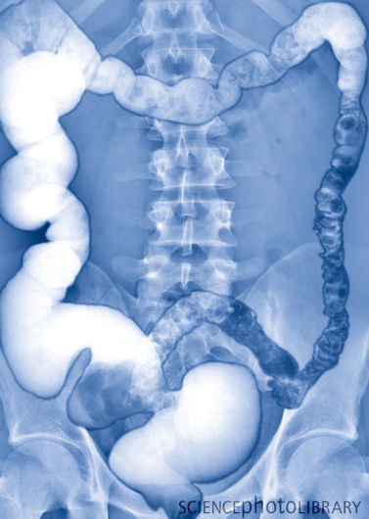
BAREUM ENEMA TEST

Slide 36
X-ray of the anorectal area (defecography)
In this X-ray procedure, patient’s rectum fills with a soft paste with the same consistency as stool.
As he expel the paste, X-rays are taken to evaluate the completeness of stool elimination and rectal muscle contractions.
.

Slide 37
Examination of the rectum and lower, or sigmoid, colon (sigmoidoscopy)
In this procedure, doctor inserts a lighted, flexible tube into anus to examine rectum and the lower portion of colon.
Examination of the rectum and entire colon (colonoscopy)
In this doctor examine the entire colon with a flexible, camera-equipped tube.

Slide 38
Evaluation of anal sphincter muscle function (anorectal manometry).
In this procedure, doctor inserts a narrow, flexible tube into anus and rectum and then inflates a small balloon at the tip of the tube.
The device is then pulled back through the sphincter muscle. This procedure allows do to measure the coordination of the muscles which is used to move bowels.

Slide 39
Evaluation of how well food moves through the colon (marker study or colorectal transit study).
In this procedure, patient swallow a capsule containing markers that show up on X-rays taken over several days.
Then this shows the signs of intestinal muscle dysfunction and how well food moves through colon.

Slide 40
SYMPTOMS
Difficult bowel movement
Dry bowel movement
Painful bowel movement
Dry feces, small feces, hard feces
Absent bowel movement
Infrequent bowel movement
Fecal straining
Abdominal pain and bloating
Nausea, vomiting, weight loss, uncomfortable feeling, fatigue, and diarrhea.

Slide 41
Aims of Treatment
Regular habits of evacuation
Follow a regular meal pattern
Consume a high fiber diet
Ensure an adequate intake of fluids
Encrease exercise and activity

Slide 42
Dietary management
CALORIES
According to age ,sex and occupation should be given.
FIBER
The fiber intake should be increased upto 12 – 18%
High fiber foods – whole grain cereals ,
whole pulses,
green leafy vegetables and fruits.

Slide 43
FLUIDS
Fluid- 8-10 glasses of water for better stool formation.
VITAMINS
B-complex vitamins- should be increased .
FAT
Fats stimulate the flow of bile and also lubricate the bowel.
Exercises- Regular exercise (especially abdominal muscle exercises) and brisk walking .
Avoid high refined and concentrated foods.

Slide 44
EXCEPTIONS
In oligosaccharide deficient constipated patients, legumes must not be increased as it can produce problems with gas
High phytic acid content foods avoided by patients whose mineral balance may be unstable
( elderly women & sedentary worker men)

Slide 45
FLATULENCE
It is an abdominal discomfort due to the excessive formation of gases in the stomach or intestine.
Gas can be expelled from the digestive tract either as belching from the stomach or as flatus from the rectum.
Belching (also known as burping) is the release of gas from the digestive tract (mainly esophagus and stomach) through the mouth.

Slide 46
FLATUS
The medical term for the mixture of gases is flatus.
Components of the flatus
Nitrogen: 20–90%
Hydrogen: 0–50%
Carbon dioxide: 10–30%
Oxygen: 0–10%
Methane: 0–10%

Slide 47
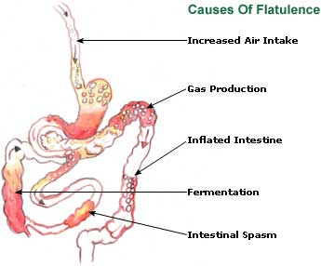
CAUSES
Swallowed air (aerophagia)
Breakdown of undigested foods/ Fermentation
Foods can cause GAS
Beans
Starches
Onion
Dark beer and Red wine
Sorbitol
Fiber
Lactase deficiency

Slide 48
SYMPTOMS
Gas: More than the normal output.
Belching: can cause more
serious
upper GI disorder such as
peptic ulcer disease,
gastroesophageal reflux disease
(GERD), or gastroparesis.

Slide 49
Abdominal bloating
Irritable bowel syndrome
Abdominal pain
Discomfort.

Slide 50
Diagnosis
By measuring the amount of hydrogen in the patient's breath after the person eats suspected foods
Analysis of flatus for gas content. This should help differentiate gas produced by swallowing air from gas produced in the gastrointestinal (GI) tract.
Blood test : Lactose intolerance
X- rays
Colonscopy

Slide 51
Treatment
DIET
Meals: 3-4 smaller meals
Excessive food intake should be avoided.
Proteins and Carbohydrates
Pulses are best excluded.
Rice and potato in small quantities.
Avoided – Fried and spiced food
Fluids- 8-10 glasses
Fibre
Milk

Slide 52
Taking medicines: antibiotics
Reduce amount of air swallowed
Proper chewing
Eradicating intestinal infections and managing organic disease :
Peptic ulcer .

Slide 53
MALABSORPTION SYNDROME
This occurs when the normal digestion and absorption of food is interrupted.
Classification
SELECTIVE
As seen in lactose malabsorption
PARTIAL
As observed in a-Beta-lipoproteinaemia,
TOTAL
Celiac disease

Slide 54
AETIOLOGY
Due to infective agents
Intestinal tuberculosis
HIV related malabsorption
Diarrhoea
Parasitese.eg. fish tape worm (B₁₂ malabsorption); roundworm, hookworm .

Slide 55
Due to mucosal abnormality
Coeliac disease
Cows' milk intolerance
Soya milk intolerance
Fructose malabsorption

Slide 56
Due to enzyme deficiencies
Lactase deficiency inducing lactose intolerance
Sucrose intolerance
Intestinal disaccharidase deficiency
Intestinal enteropeptidase deficiency

Slide 57
Due to digestive failure
Pancreatic insufficiencies:
cystic fibrosis
chronic pancreatitis
carcinoma of pancreas

Slide 58
Symptoms
Bloating, cramping, and gas
Chronic diarrhea (may not occur with vitamin malabsorption)
Fatty stools (steatorrhea)
Muscle wasting
Weight loss

Slide 59
CELIAC DISEASE
Celiac disease is a digestive disease that damages the small intestine and interferes with absorption of nutrients from food.
CAUSES
Genetic predisposition
Immune component:
Antibodies to specific dietary protein fractions
Intolerance of gluten

Slide 60
Immune system damage villi

Slide 61
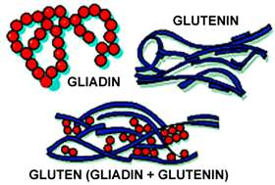
GLUTEN
Protein found in wheat, rye and in barley.
2 fractions – glutenin and gliadin.

Slide 62
FOODS
GLUTEN FREE | GLUTEN RICH
Legumes | Wheat, rye, barley.
Nuts and seeds | Bread, cookies
Fruits and vegetables | Pasta , macroni
Meat , fish , polutry, eggs and Milk and milk products | Wheat germ oils
Whole grains : | Some herbal tea
brown rice ,gram flour(from chickpea) | Some alcholic drinks
corn | Pizza crust
buckwheat
Oat, oatmeal ,sorghum.

Slide 63
SYMPTOMS
Atropy of villi
Reduced area for absorption
Reduced nutrient transport carriers
Anemia
Bone loss
Muscle weakness
Chronic diarrhea
Chronic constipation
Malabsorption

Slide 64
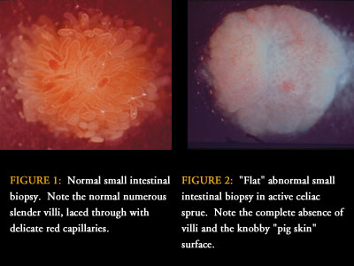
Diagnosis
Blood tests and Screening:
- To detect autoantibodies - antitissue transglutaminase antibodies (tTGA) or anti-endomysium antibodies (EMA).
Intestinal biopsy
-Remove tiny piece of tissue from inestine
– to check for damage to VILLI
Endoscopy.

Slide 65
Dermatitis Herpetiformis
Dermatitis herpetiformis (DH) is an intensely itchy, blistering skin rash that affects 15 to 25 percent of people with celiac disease.³ The rash usually occurs on the elbows, knees, and buttocks. Most people with DH have no digestive symptoms of celiac disease.
DH is diagnosed through blood tests and a skin biopsy
Stool examination for malabsorption
Stool from patients with celiac disease often contains many stained globules of fat.

Slide 66
Medical management
Electrolyte and fluid replacement
Iron supplementation
Nutritional management
Restrict gluten sources
Vitamins and minerals supplementation
Give CHO
Calcium and Vitamin- D adminstration
Supplementation with omega- 3- fatty acids

Slide 67
CARBOHYDRATE INTOLERANCE

Slide 68
Carbohydrate intolerance is the inability of the body to completely process the nutrient carbohydrate ( includes sugars and starches) into a source of energy for the body.
CAUSES
Enzyme deficiency
Malabsorption of other nutrients.
TYPES
SUCROSE DEFICIENCY
FRUCTOSE DEFICIENCY
LACTOSE DEFICIENCY

Slide 69
COGENITAL SUCRASE- ISOMALTASE DEFICIENCY
inherited error of metabolism in which patients are born with absent or low level of 2 digestive enzymes :SUCARSE AND ISOMALTASE
SYMPTOMS:
Vomiting
Watery Diarrhea
Fatigue
Dehydration
Abdominal Cramps

Slide 70
FRUCTOSE MAL-ABSORPTION
It is the inability to absorb fructose( fruit sugar).
SYMPTOMS:
Bloating(from small intestine to large intestine)
Diarrhea or constipation
Flatulence
Vomiting
OTHER SYMPTOMS INCLUDE:
Aching eyes
Fuzzy head
Fatigue

Slide 71
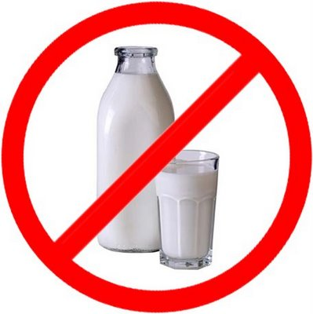
LACTOSE INTOLERANCE
Lactose intolerance, also called lactase deficiency and hypolactasia, is the inability to digest lactose, and to a lesser extent milk-derived dairy products.

Slide 72
CAUSES
Primary lactase deficiency is genetic, only affects adults and is caused by the absence of a lactase persistence allele.
Secondary, acquired, or transient lactase deficiency is caused by an injury to the small intestine, usually during infancy, from acute gastroenteritis, diarrhea, chemotherapy, intestinal parasites or other environmental causes.
Congenital lactase deficiency is a very rare, autosomal recessive genetic disorder that prevents lactase expression from birth. People with congenital lactase deficiency , unable to digest lactose from birth, and they are unable to digest breast milk.

Slide 73
DIAGNOSIS
Hydrogen breath test
Blood test
Stool acidity test
Intestinal biopsy
Stool sugar chromatography

Slide 74
Nutritional care
Decrease consumption of lactose containing foods.
Solid and semi-solid milk products such as aged chesse as well tolerated because gastric emptying of these foodstuffs are slower than for liquid milk beverages
Lactase enzymes and milk products treated with lactase enzyme are available for lactose maldigester who have discomfort with milk.

Slide 75
Levels of LACTOSE in milk foods
Dairy product | Serving size | Lactose content | Percentage
Milk, regular | 250 ml | 12 g | 4.80%
Milk, reduced fat | 250 ml | 13 g | 5.20%
Yogurt, plain, regular | 200 g | 9 g | 4.50%
Yogurt, plain, low-fat | 200 g | 12 g | 6.00%
Cheddar cheese | 30 g | 0.02 g | 0.07%
Cottage cheese | 30 g | 0.1 g | 0.33%
Butter | 1 tsp (5.9ml) | 0.03 g | 0.51%
Ice cream | 50 g | 3 g | 6.00%

Slide 76
SYMPTOMS
Symptoms often occur 30 minutes to 2 hours after eating or drinking milk products, and are often relieved by not eating or drinking milk products.
Large doses of milk products may cause worse symptoms.
Abdominal bloating
Abdominal cramps
Diarrhea
Gas
Nausea
Infants or children may have slow growth or weight loss.

Slide 77
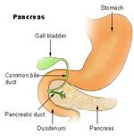
STEATORRHEA
Steatorrhea is the medical term for fat in stool.
Fat in the stool can cause bulky stool that floats, has an oily or greasy appearance, and smells foul.
Fat in the stool is fat that the digestive tract was unable to absorb.

Slide 78
CAUSES
lack of bile acids (due to liver damage, hypolipidemic drugs.
The absence of bile acids cause the feces to turn gray or pale.
Defects in pancreatic enzymes
Defective mucosal cells.
Associated diseases
malabsorption, e.g. inflammatory bowel disease, celiac disease
Pancreatitis
bacterial overgrowth
short bowel syndrome
cystic fibrosis

Slide 79
symptoms
Digestive tract symptoms that may occur along with steatorrhea
Abdominal pain or cramping
Abdominal swelling, distension or bloating
Abnormally foul-smelling stools
Bloody stool (the blood may be red, black or tarry in texture)
Diarrhea
Gas
Nausea with or without vomiting
Pale feces

Slide 80
Other symptoms that may occur along with steatorrhea
Cough
Dark urine
Frequent infections
Itchy skin
Unexplained weight loss
Yellowing of the skin and whites of the eyes (jaundice)

Slide 81
Diagnosis and Tests
Pancreatic and small intestinal diseases are the major causes of Steatorrhea .
If steatorrhea is due to chronic PANCREATITIS the bentiromide test is usually abnormal.
To confirm the presence of pancreatic disease
- Abdominal X-ray
-Ultrasound
- CT scan

Slide 82
When small intestinal disease is suspected as the source of steatorrhea, function tests of intestinal absorption may be performed.
D-xylose absorption will test proximal small bowel function.
The Schilling tests (I and II) and bile acid breath tests assess distal small bowel function.
The Schilling test with antibiotics (part III) and the bile acid breath test will facilitate a diagnosis of bacterial overgrowth.
Biopsy - Structural abnormalities of the small bowel.

Slide 83
Nutritional care
Dietary protein and CHO should be high.
Fat is added as tolerated to meet individual needs.
The presence of wt. loss require an increase in energy input.
Multiple vitamin and mineral deficiency necessitate supplemental therapy.
Special emphasis on fat soluble vit. & minerals such as ca, zinc, mg, fe.

Slide 84
IRRITABLE BOWEL SYNDROME
Irritable bowel syndrome (IBS, or spastic colon) it is characterized by chronic abdominal pain, discomfort, bloating,and alteration of bowel habits.

Slide 85
CAUSES
Abnormal gastrointestinal (GI) tract movements.
Gastroenteritis
After an intestinal infection. This is called post infectious IBS.
Stress - The colon is connected to the brain through nerves of the autonomic nervous system. These nerves become more active during times of stress, and can cause the intestines to squeeze or contract more. People with IBS may have a colon that is over-responsive to these nerves .

Slide 86
SYMPTOMS
Abdominal cramping and pain that are relieved with bowel movements .
Alternating periods of diarrhea and constipation
Change in the stool frequency or consistency
Gassiness (flatulence)
Passing mucus from the rectum
Bloating
Abdominal distension

Slide 87
DIAGNOSIS AND TESTS
Medical and Dietary History
Physical exam
Feeling the abdomen.
A digital rectal exam.
Listening for bowel sounds (with a stethoscope).
A routine pelvic exam (in women).
Blood Test
Complete blood count (CBC)
- information about the kinds and numbers of red blood cells, white blood cells, and platelets in the blood; and sedimentation rate, which checks for inflammation in the body.

Slide 88
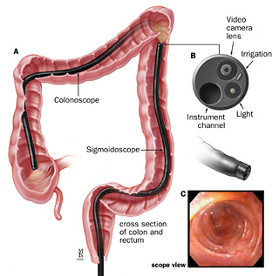
Stool analysis, which may include testing for blood in the stool (fecal occult blood test), infection (stool culture), or parasites (ova and parasites test).
Colonoscopy

Slide 89
NUTRITIONAL CARE
Change in lifestyle
Dietary changes can be helpful.
Avoid foods and drinks that stimulate the intestines (such as caffeine, tea, or colas)
Avoid large meals.
Avoid wheat, rye, barley, chocolate, milk products, and alcohol.
Increase dietary fiber.

Slide 90
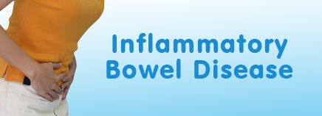
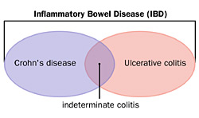
IBD is a group of inflammatory conditions of the colon and small intestine.

Slide 92
CRHON’S DISEASE

Slide 93
CAUSES
Infection by certain bacteria, such as strains of mycobacterium, may be the cause of Crohn's disease.
Activation of the immune system causes inflammation within the tissues.
First degree relatives (brothers, sisters, children, and parents) of people with IBD are more likely to develop these diseases.

Slide 94
How CROHN’S DISEASE EFFECTS INTESTINE
It causes small, scattered, shallow, crater-like ulcerations (erosions) on the inner surface of the bowel.
Then the erosions become deeper and larger, ultimately becoming true ulcers (which are deeper than erosions), and causing scarring and stiffness of the bowel.
The bowel becomes increasingly narrowed, and ultimately can become obstructed.
Deep ulcers can puncture holes in the wall of the bowel, and bacteria can spread to infect adjacent organs and to the empty abdominal cavity and form pus and other infections.

Slide 95
TYPES and SYMPTOMS
Crohn's colitis- inflamation of colon
- abdominal pain
-bloody diarrhea
Crohn’s enteritis – inflamation of intestine
- abdominal pain
- diarrhea
Crohn's terminal ileitis - inflammation that affects only the very end of the small intestine (terminal ileum)
Crohn's entero-colitis and ileo-colitis-inflammation that involve both the small intestine and the colon

Slide 96
Ulcerative colitis
Ulcerative colitis is a disease of the colon (large intestine), that includes:
ulcers or open sores.
It causes inflammation of the colon's inner lining and the rectal wall, which becomes red, swollen, and ulcerated.

Slide 97
CAUSES
Genetic factors
Diet
Stress
Autoimmune disease- immune system malfunctions.
Intake of antibiotics

Slide 98
TYPES and SYMPTOMS
Ulcerative proctitis - inflammation that is limited to the rectum.
Rectal bleeding
-rectal pain
- rectal inflammation
- urgency
Proctosigmoiditis - inflammation of the rectum and the sigmoid colon (a short segment of the colon contiguous to the rectum).
-rectal bleeding
-urgency
- diarrhea
-cramps

Slide 99
Left-sided colitis -inflammation that starts at the rectum and extends up the left colon (sigmoid colon and the descending colon).
bloody diarrhea
abdominal cramps
weight loss
left-sided abdominal pain
Pancolitis or Universal colitis- inflammation affecting the entire colon (right colon, left colon, transverse colon and the rectum).
bloody diarrhea
abdominal pain and cramps
weight loss,
fatigue
fever, and night sweats

Slide 101
Diagnostic Tests
TESTS | CROHN’S and ULCERATIVE COLITIS
BLOOD TEST | indicate anemia or inflammation gives counts of erythrocytes, protein & c-reactive protein Erythrocyte Sedimentation rate
STOOL SAMPLE | check for blood and signs of inflammation or infection, including parasites

Slide 102
TESTS ENDOSCOPY CT Scan (Computed tomography Scan) | CROHN’S DISEASE and ULCERATIVE COLITIS a capsule containing miniature video camera is swallowed capsule travels through the small intestine, it sends video images of the lining of the small intestine to a receiver carried on a belt at the waist. images are downloaded and then seen in a computer. Type of X- ray provide cross- sectional view of body Show the body’s internal organs and tissues.

Slide 103
TESTS COLONOSCOPY | CROHN’S DISEASE and ULCERATIVE COLITIS Detect small ulcers or small areas of inflammation of the colon and terminal ileum Small tissue samples (biopsies) can be obtained
Barium X-ray | ingested orally, it fills the intestine, and pictures (X-rays) can be taken of the stomach and the small intestines. show ulcerations, narrowing, and, sometimes, fistulae of the bowel when administered through the rectum.

Slide 104
Nutritional care
CALORIE-
-adequte supply - about 2000-2500kcal
PROTEIN
-ulcerative colitis patient –losses of 4-8 gm nitrogen per day .
-Normal excretion is 2gm daily
-serum albumin levels low.
CHO
-easily absorbable

Slide 105
Vitamins
-multivitamin preprations should be administered orally or injected
Minerals
Sodium
Potassium
Iron-
Elemental iron should be given .
If anemia is there 100 mg of iron dextrin should be given.

Slide 106
COMPARISON
 | ULCERATIVE COLITIS | CROHN’S DISEASE
Most common sites | Rectum | Terminal ileum
Distribution | Rectum to colon”backwash” ileitis | Mouth to anus
Spread | Continous | Discontinuity”skip lesions”
Gross features | Extensive ulceration | Focal appthous ulcers with intervening normal mucosa
 | Pseudo-polyps | Linear fissures
 |  | Cobbelstone apperance
 |  | Thickened bowel wall

Slide 107
 | ULCERATIVE COLITIS | CROHN’S DISEASE
Micro | No granulomas | Granulomas
Inflamation | Low | More
Complication | Toxic megacolon | Strictures, obstruction
 |  | Abscess, Fistula
Cancer risk | 5-25% | Slight 1-3%
Presentation | Bloody diarrhea | Variable: Pain ,Diarrhea, Wt. loss
Extraintestinal manifestation | Common | Uncommon

Slide 110
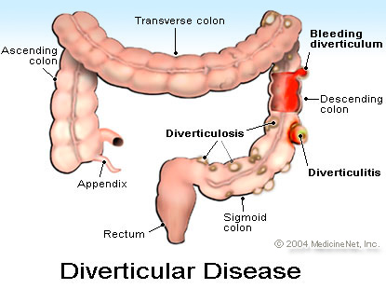
DIVERTICULITIS
DIVERTICULOSIS
- It refers to sac –like herniations of the colonic wall.
- Intra colonic pressures and muscular thickening result from complete closure of colonic segments during contractions associated with attempts to small,dry or hard fecal material through the lumen of the bowel.
Diverticulitis is a condition in which diverticuli
in the colon rupture.
The rupture results
in infection in the
tissues that
surround the colon
and due to inflamed
diverticula.

Slide 111
CAUSES
Diet- Lack of fiber
Lack of exercise
Constipation
Inflammation may begin when bacteria or stool are caught in the diverticula

Slide 112
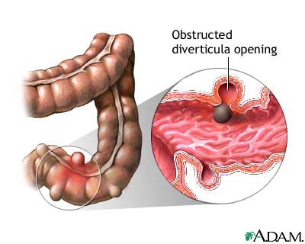
SYMPTOMS
Abdominal cramping,
Constipation
Diarrhea
Collection of pus (abscess) in the pelvis,
Colon obstruction,
Infection of the abdominal cavity
Bleeding into the colon

Slide 113
TREATMENT
Clearing up the infection and inflammation with antibiotics.
Resting the colon with a liquid diet plus a pain reliever or a drug such as propantheline (Pro-Banthine) to control muscle spasms.
Preventing or minimizing complications with the proper diet.

Slide 114
DIAGNOSTIC TESTS:
Barium X-rays (barium enemas) can be performed to visualize the colon. Diverticula seen as barium filled pouches protruding from the colon wall.
Sigmoidoscopes & colonoscopes
Direct visualization of the intestine can be done with flexible tubes inserted through the rectum and advanced into the colon
Ultrasoundand CT scan examinations of the abdomen and pelvis can be done to detect collections of pus fluid.
In patients having diverticular abscess causing persistent pain and fever.

Slide 115
DIET
Increase fiber content in food gradually
Avoid refined flour breads and consume whole grain breads
Consume fruits such as apples, peaches, bananas, oranges, pears and berries
legumes, beans, peas and lentils
brown rice, whole-wheat pasta and barley
Snack on whole-grain crackers
Add wheat bran to salads, casseroles and baked goodies
Consume vegetables such as carrots, broccoli, asparagus and salad greens

Slide 116
Short bowel syndrome
(SBS, also short gut syndrome ) is a malabsorption disorder caused by the surgical removal of the small intestine.
Due to the complete
dysfunction of a large
segment of bowel.

Slide 117
CAUSES
Crohn's disease
Volvulus( a spontaneous twisting of the small intestine that cuts off the blood supply and leads to tissue death)
Tumors of the small intestine
Injury
Necrotizing enterocolitis (premature newborn)
Bypass surgery to treat obesity
Surgery to remove diseases or damaged portion of the small intestine

Slide 118
SYMPTOMS
Abdominal pain
Diarrhea and steatorrhea
Fluid depletion
Weight loss and malnutrition
Fatigue
Malabsorption of vitamins and minerals, such as deficiencies in vitamins A, D, E, K, and B12, calcium, magnesium, iron, folic acid, and zinc.
Appear as anemia, hyperkeratosis (scaling of the skin), muscle spasms
Poor blood clotting
Bone pain.

Slide 119
Diagnosis ans TEST
Medical history and Physical examination
Blood test
-detect anemia
Stool Test
-absorption of dietary fat
CT scan
- abnormalities in intestine
X-ray
- kidney stones
- gallstones
Endoscopy
- inspect esophagus, stomach and duodenum.
Colonoscopy
- inspect colon and lower small intestine.

Slide 120
TREATMENT
Anti-diarrheal medicine
Vitamin, mineral supplements
H2 blocker and proton pump inhibitors to reduce stomach acid
Lactase supplement (to improve the bloating and diarrhoea associated with lactose intolerance)
Surgery, including intestinal lengthening, tapering, and small bowel transplant.
Parenteral nutrition
Nutrition administered via gastrostomy tube.

Slide 121
SYMPTOMS
Loss of appetite
Nausea
Diarrhea
Fullness after a meal
Fatty stools
Unintentional weight loss
weakness

Slide 122
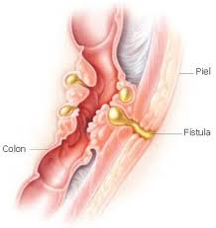
FISTULA
It can be defined as the connection of two body cavities (such as the rectum and the vagina) or as the connection of a body cavity to the skin (such as the rectum to the skin) which is not a normal occurrence.

Slide 123
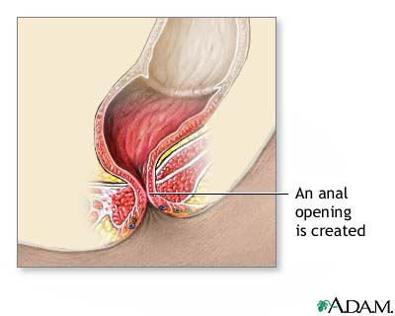
HOW IT DEVELOP?
ANAL fistula may form , from an abscess .
The abscess may be constantly filling with body fluids such as stool or urine, which prevents healing.
The fistula breaks through to the skin, another body cavity, or an organ.
Other causes
- IBD
- Crohn’s disease
- AIDS

Slide 124
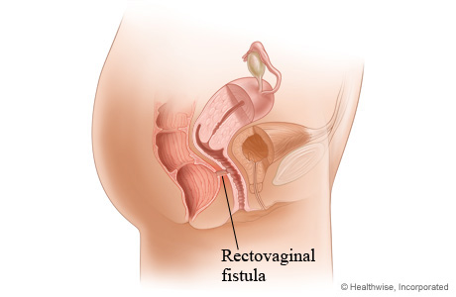
Rectovaginal fistulas –
Injury to the perineum (the area of tissue between the vagina and the rectum) during child birth
IBD
Vaginal surgries
Rectal surgries

Slide 125
SYMPTOMS
Pain
fever
tenderness
itching
Gas through vagina
The fistula may also drain pus or a foul-smelling discharge
Painful urination
Inflamation of vagina which results
Itiching and burning in vagina

Slide 126
TYPES
Enterocutaneous: This type of fistula is from the intestine to the skin.
Enteroenteric or Enterocolic: This is a fistula that involves the large or small intestine.
Enterovaginal: This is a fistula that goes to the vagina.
Enterovesicular: This type of fistula goes to the bladder. These fistulas may result in frequent urinary tract infections, or the passage of gas from the urethra during urination

Slide 127
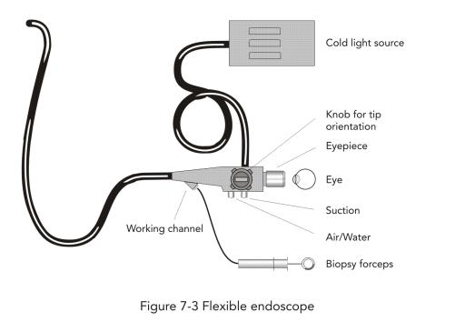
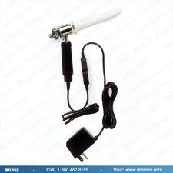
DIAGNOSIS
Physical examination
Anoscopy
An anoscop tubular instrument (also called an anal speculum) is inserted a few inches into to the anus in order to evaluate problems of the anal canal.
Endoscopy
- to examine rectum and the lower part of colon.

Slide 128
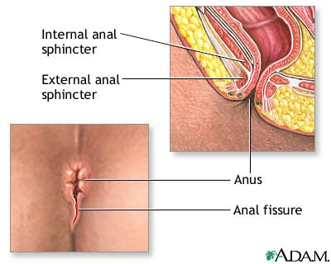
ANAL FISSURES
These are tears in the skin overlying the anal sphincter, usually due to increased tone of the anal sphincter muscles, and a failure of these muscle to relax. Anal fissures cause pain during defecation and bleeding from the anus.

Slide 129
CAUSES
Constipation
Chronic diarrhea
Crohn’s disease
Immunodeficiency diorders
Multiple pregnancies
During childbirth
Anal cancer
Leukemia
Chronic use of laxatives
Inflammation of the anus and rectum .

Slide 130
SYMPTOMS
Bright red blood in the toilet bowel
Streak of blood on toilet paper
Painful bowel movements
Itching
DIAGNOSIS
Endoscopy
Colonscopy
Sigmoidoscopy

Slide 131
TREATMENT
Eating more fiber to create softer stools
More fluid
Warm baths of anus
In Chronic Anal fissures
Anal dilation
Lateral internal sphincterotomy (LIS).

Slide 132
DIETARY FIBRE(UNAVAILABLE CARBOHYDRATE)
Many Foods Contain Non-digestable Carbohydrates. These Non-digestable Carbohydrate Designated As “Dietary Fibre”or Unavailable Carbohydrates.
It used to be believed that fibres could not be used by the human body, as the digestive juices in the body.
Our body did not contain enzymes capable of breaking down these compounds.
It was overlooked that a part of the fibre is fermented by enzymes found in the micro-organisms of the large intestines.

Slide 133
CLASSIFICATION ..
SOLUBLE FIBRES | INSOLUBLE FIBRES
PECTINS GUMS AND MUCILAGES | CELLULOSE HEMICELLULOSE LIGNIN
soluble fibres are soluble in water and become sticky in consistency
Insoluble fibre doesn’t dissolve or absorb water. it passes through our digestive system in close to its original form

Slide 134
IMPORTANCE OF FIBRE
Helps maintain bowel integrity and health. A high-fiber diet may lower your risk of developing hemorrhoids, and small pouches in your colon.
Lowers blood cholesterol levels. Soluble fiber found in beans, oats, flaxseed and oat bran may help lower total blood cholesterol levels by lowering low-density lipoprotein, or "bad," cholesterol levels.
Helps control blood sugar levels. Fiber, particularly soluble fiber, can slow the absorption of sugar, which for people with diabetes can help improve blood sugar levels
Aids in weight loss. High-fiber foods generally require more chewing time, which gives your body time to register when you're no longer hungry, so you're less likely to overeat.

